Slide 1
INTRODUCTION TO PROGRAMMING USING C PROJECT
“SNAKE GAME PROJECT”
GROUP 4
MAREEDU JYOTHI SAI SWAROOP GUDISA JAYA HAREESWAR REDDY SAI YASHWANTH PULI VENKATA SHAURYA RANNOT
AP22110010602 AP22110010605 AP22110010604 AP22110010603

Slide 2


PROBLEM STATEMENT
ALGORITHM
FLOW CHART OF THE SOLUTION
SCREENSHOT OF SOURCE CODE
OUTPUT OF SOURCE CODE
IMPROVEMENT OVER EXISTING SOLUTION
FUTURE SCOPE SUGGESTIONS

Slide 3
PROBLEM STATEMENT:
Create a program in C that will allow the user to play a game of snake. The user should be able to control the direction of a snake character to move around the screen and eat food to gain points. The game should have levels with increasing difficulty and goals that must be achieved in order to advance to the next level. The user should also be able to pause and resume the game at any point.

Slide 4
ALGORITHM:
STEP-1: Create a canvas (2D array) of a certain size. STEP-2: Create a snake that is represented by a series of points (x and y coordinates).
STEP-3: Create a method that allows the snake to move in four directions: up, down, left and right.
STEP-4: Create a method that draws the snake and the canvas on the screen.
STEP-5: Generate food on the canvas in random positions.

Slide 5
STEP-6: Create a method that checks if the snake head has collided with food or a wall.
STEP-7: If the snake has collided with food, then add a point to the snake body and generate new food on the canvas.
STEP-8: If the snake has collided with a wall, then the game is over.
STEP-9: Create a method that allows the user to control the snake using the arrow keys.

Slide 6
STEP-10: Create a method that checks if the snake has collided with itself.
STEP-11: If the snake has collided with itself, then the game is over.
STEP-12: Create a method that checks if the snake has reached the end of the canvas.
STEP-13: If the snake has reached the end of the canvas, then the game is over.

Slide 7
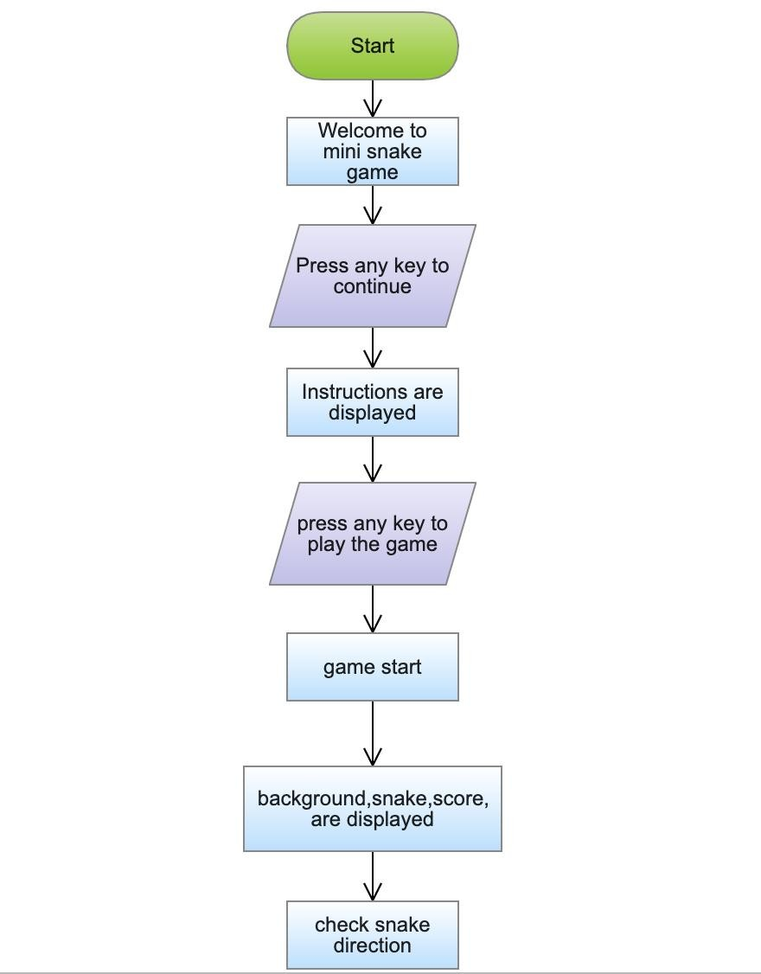
FLOW CHART:

Slide 8
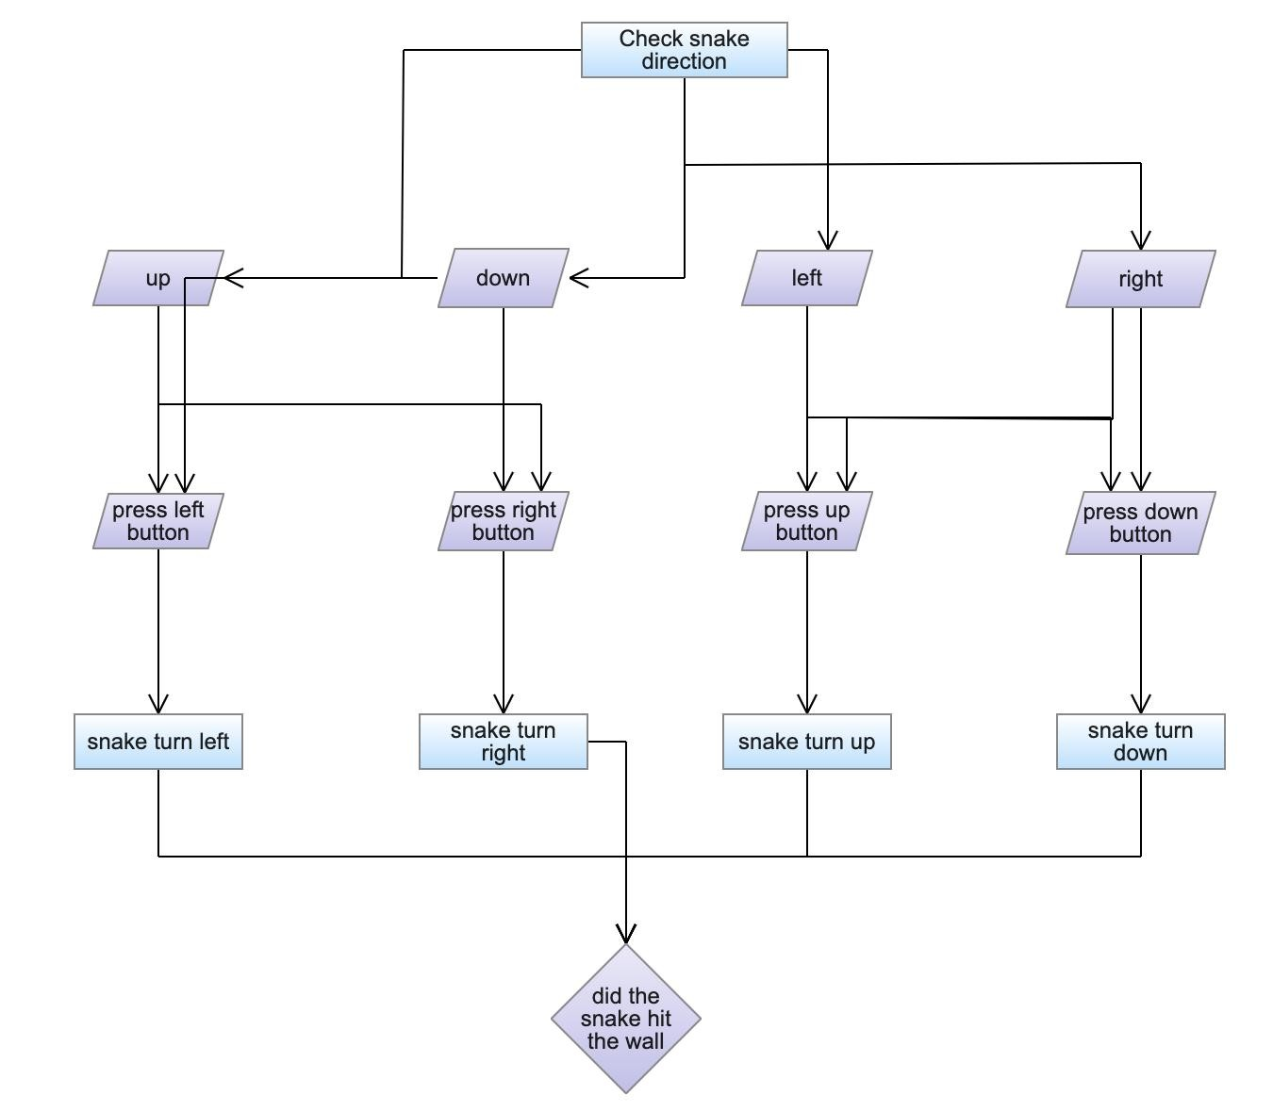

Slide 9
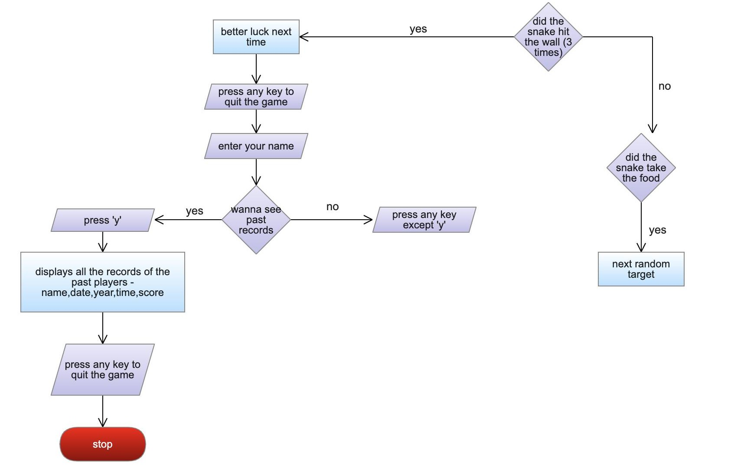
no

Slide 10
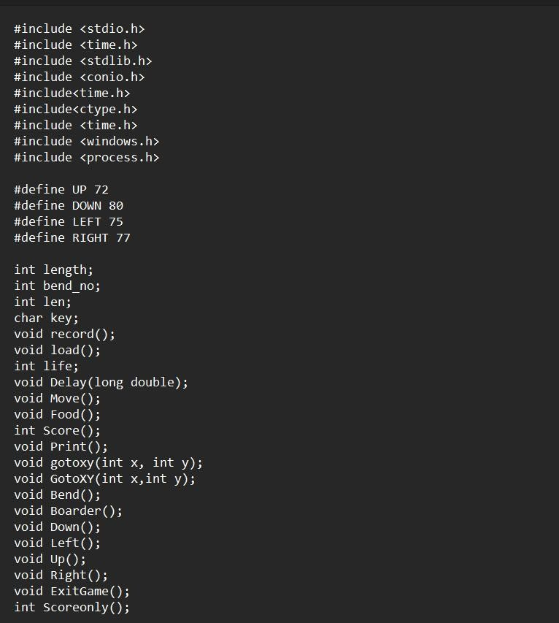
SCREENSHOT OF SOURCECODE:

Slide 11
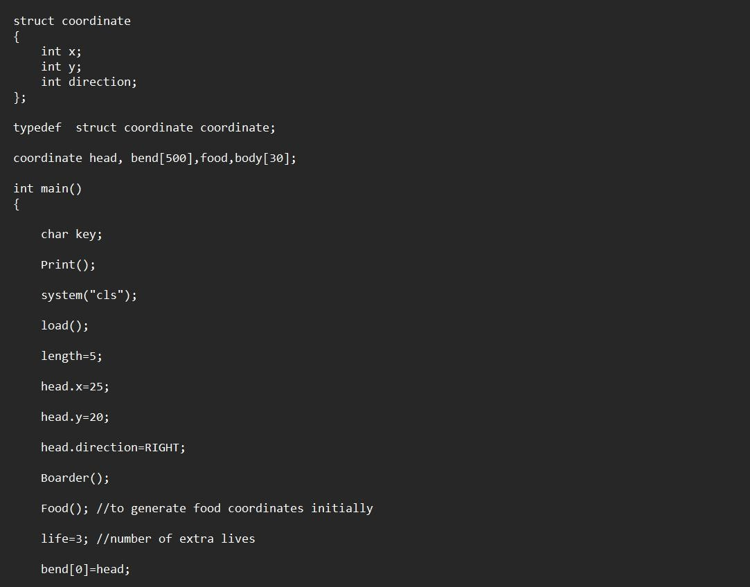

Slide 12
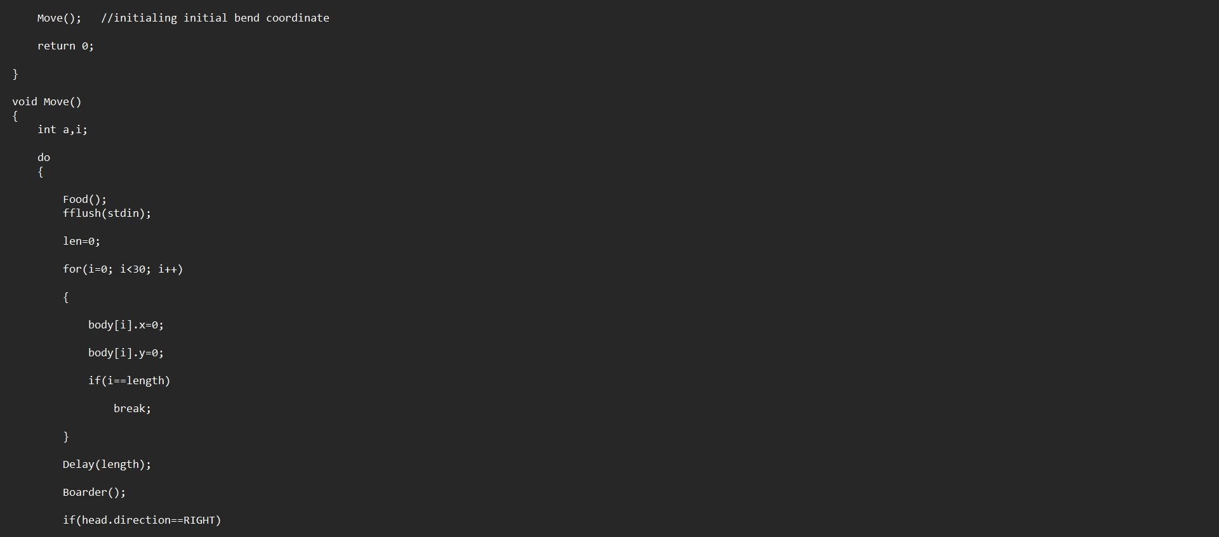

Slide 13
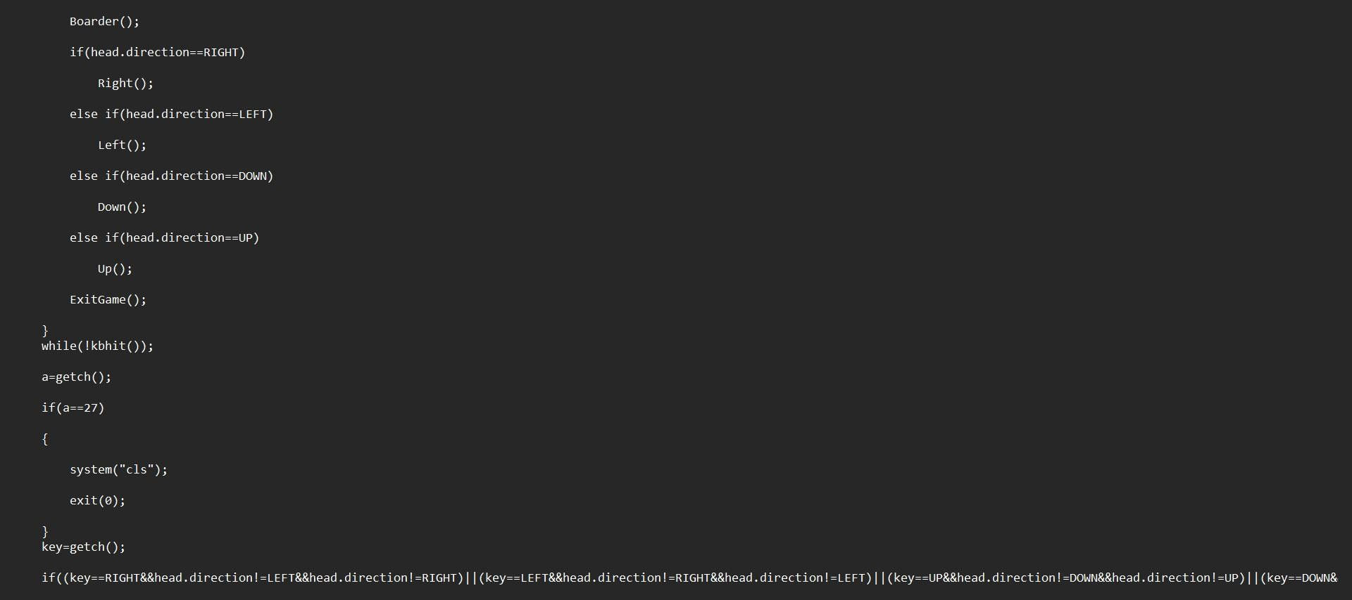

Slide 14
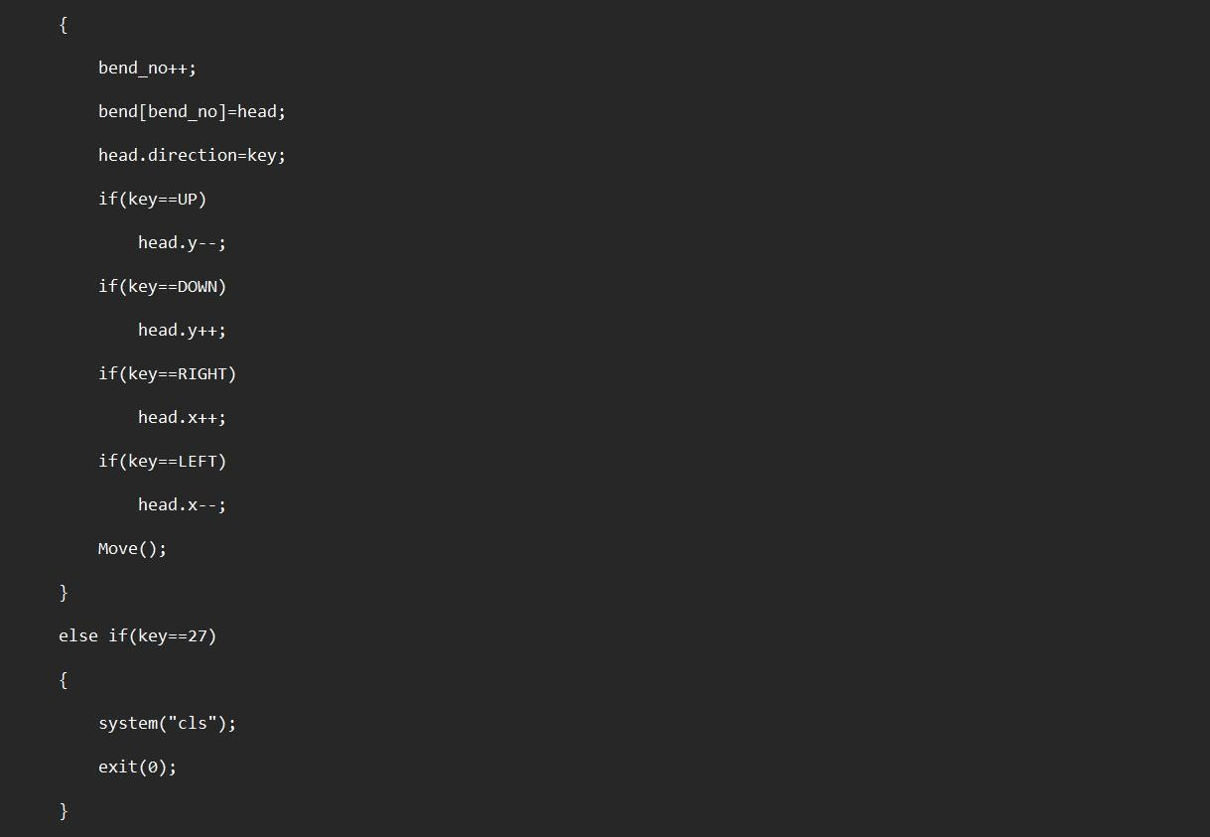

Slide 15
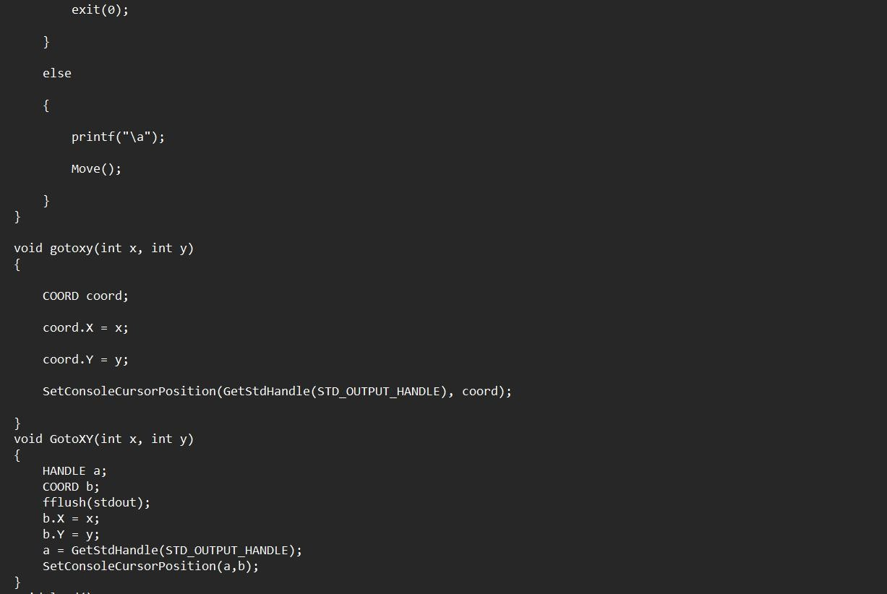

Slide 16
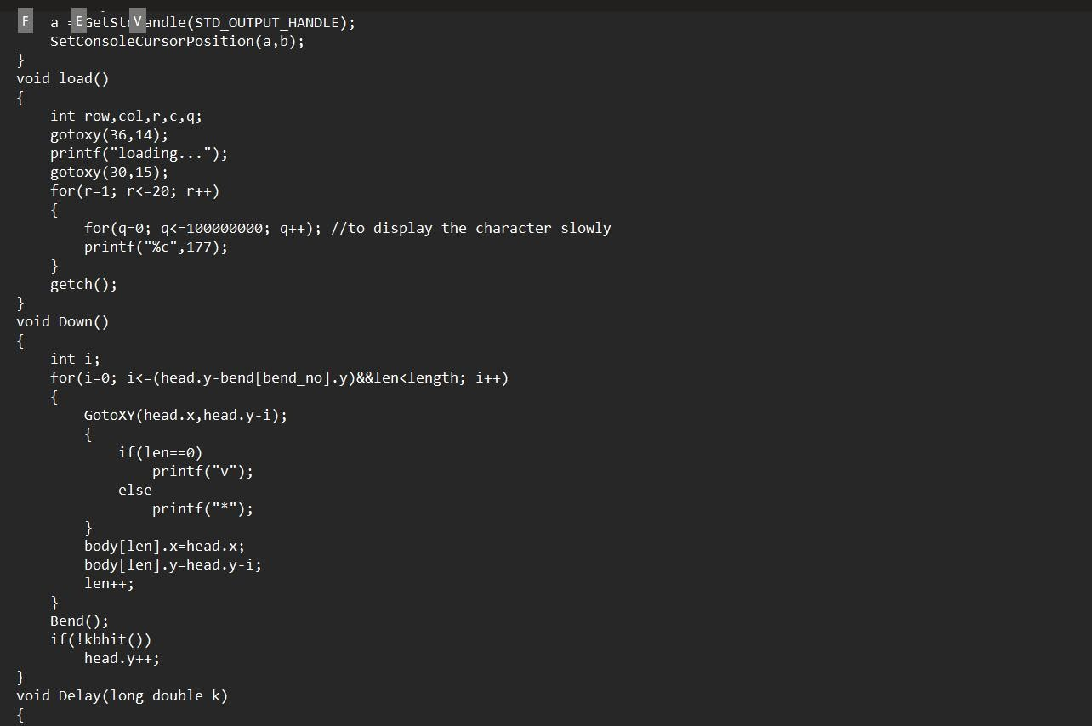

Slide 17
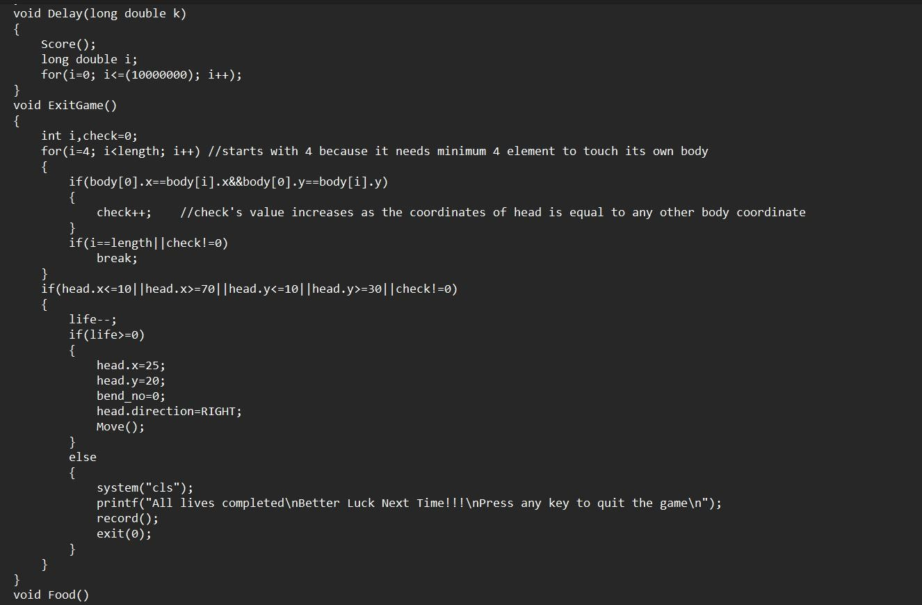

Slide 18
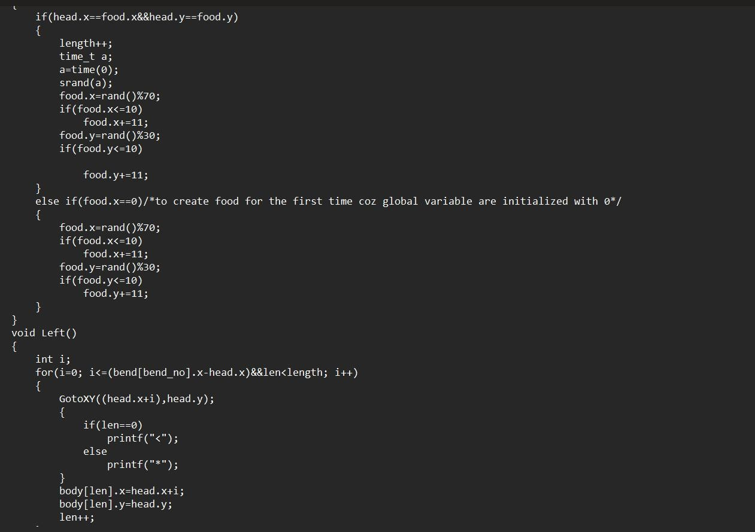

Slide 19
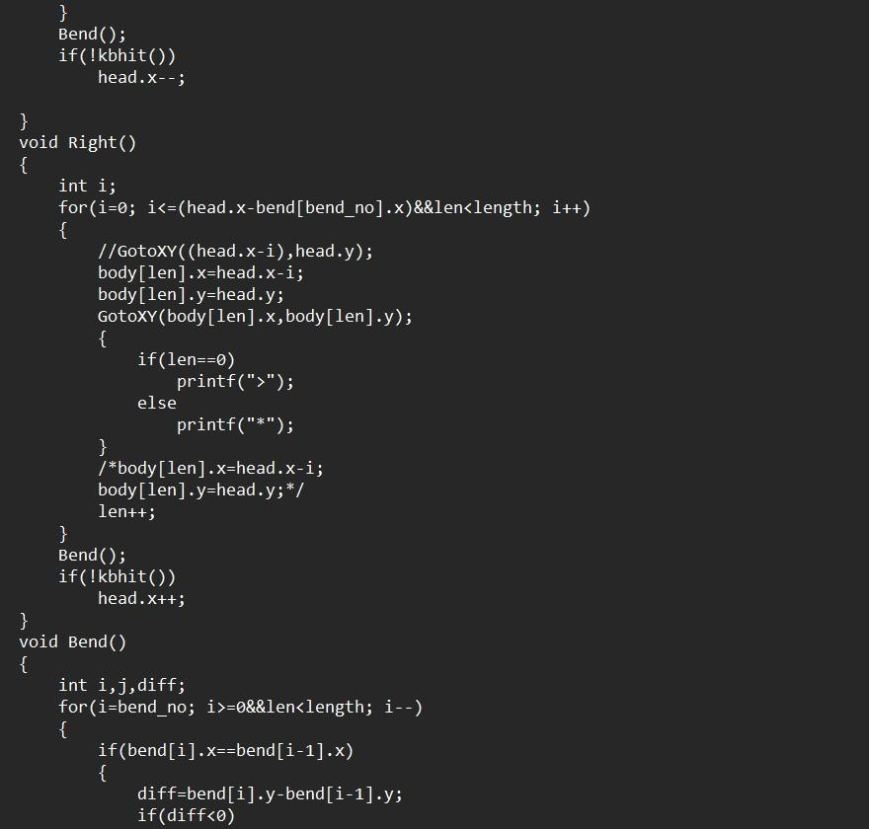

Slide 20
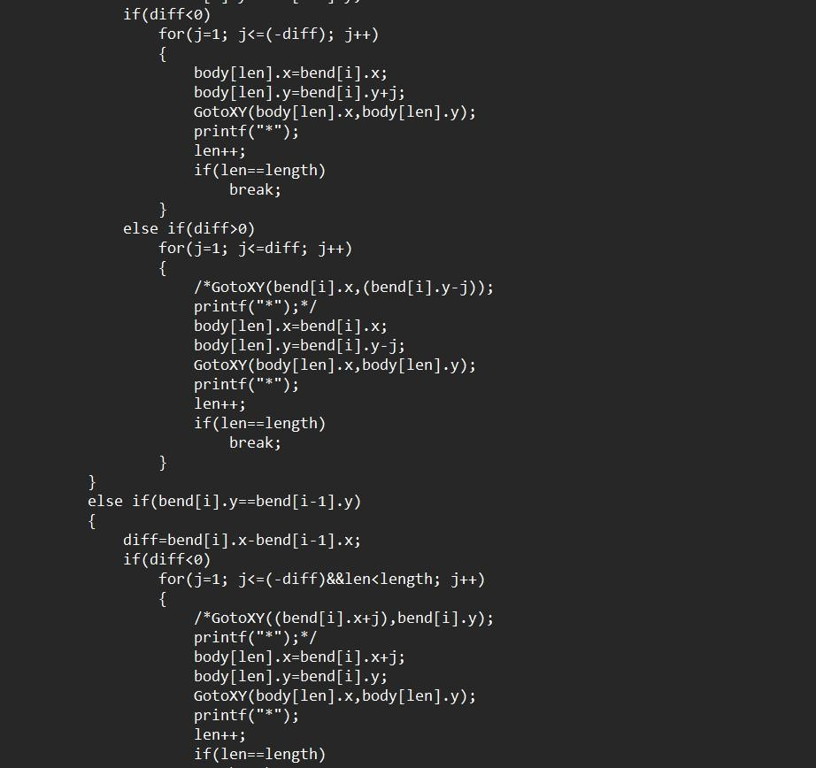

Slide 21
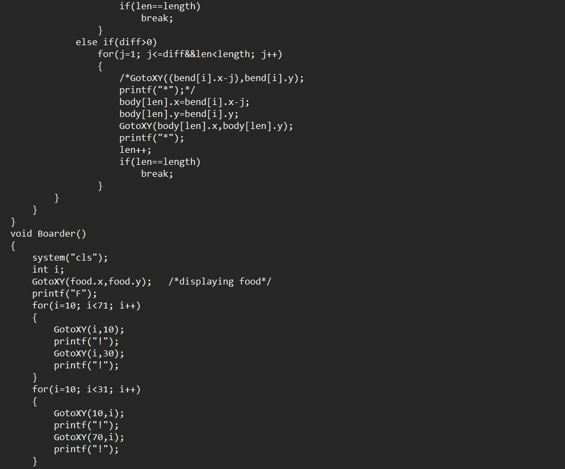

Slide 22
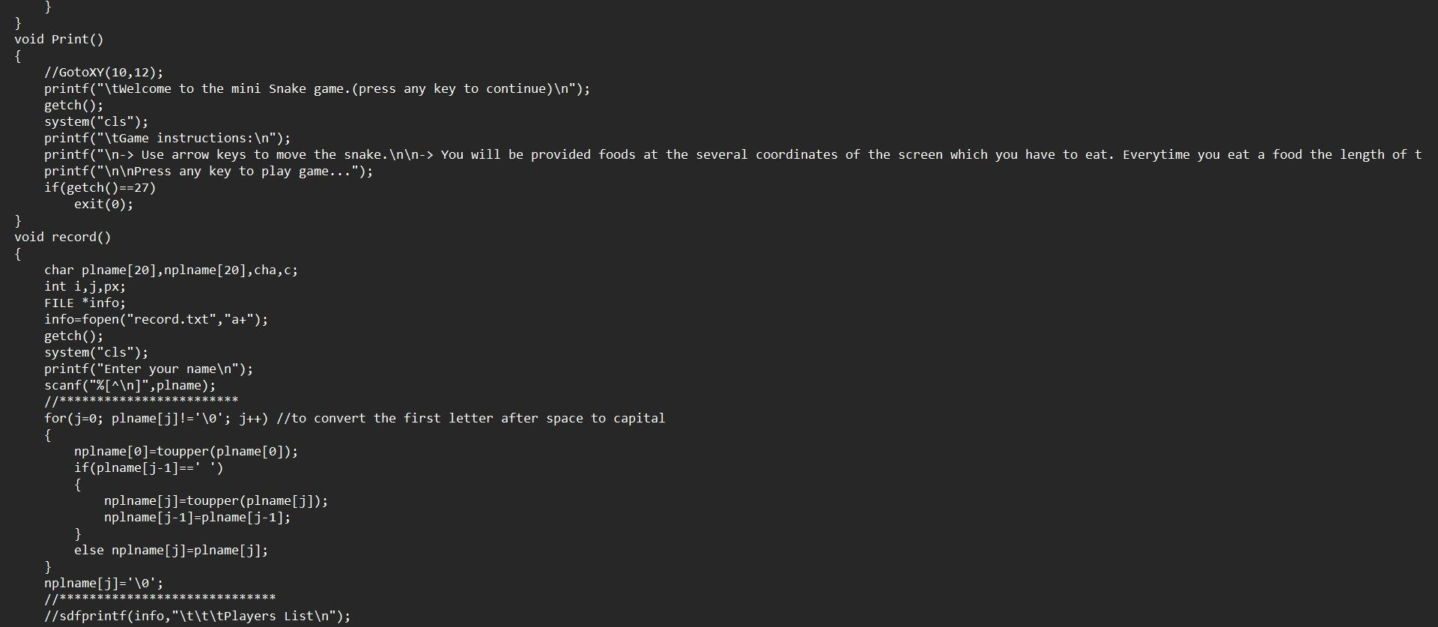

Slide 23
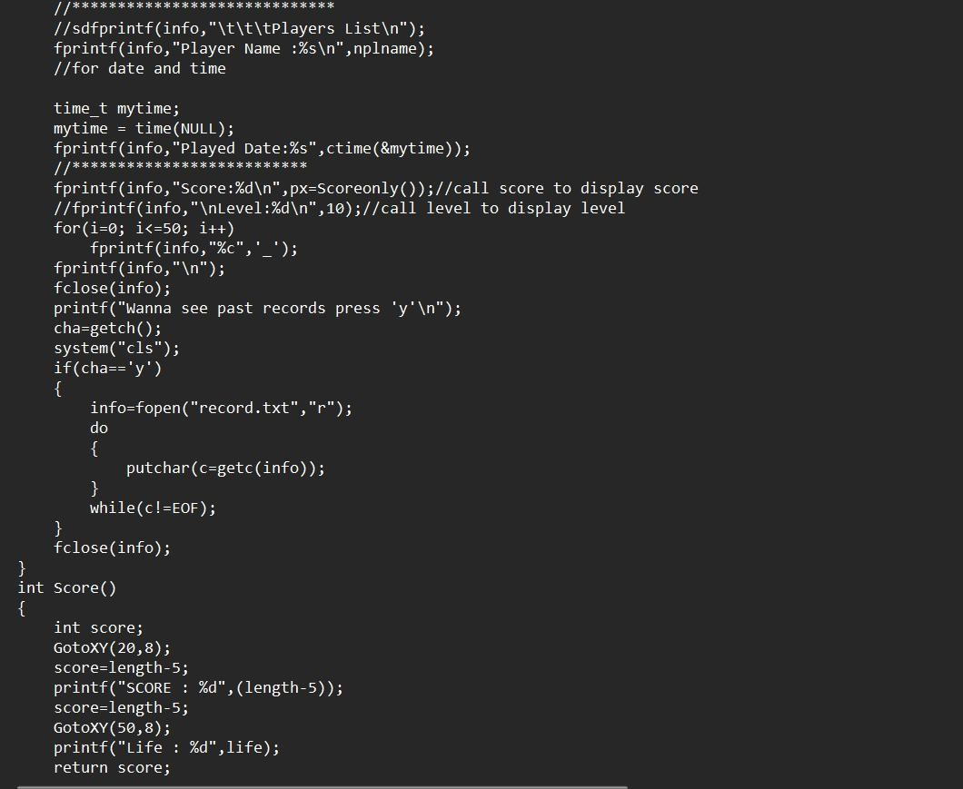

Slide 24
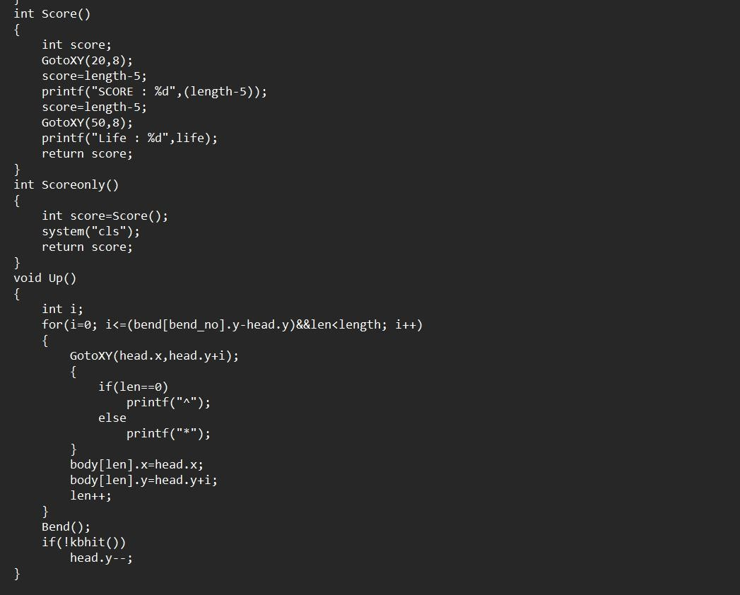

Slide 25
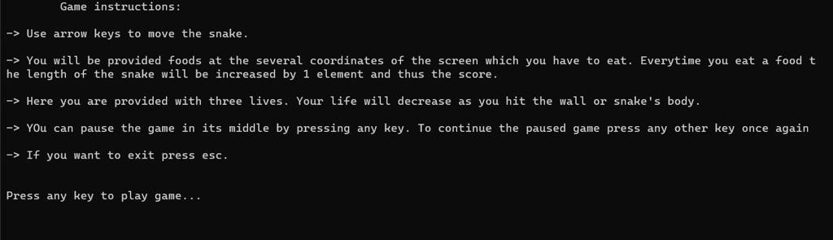
OUTPUT OF SOURCECODE:

Slide 26
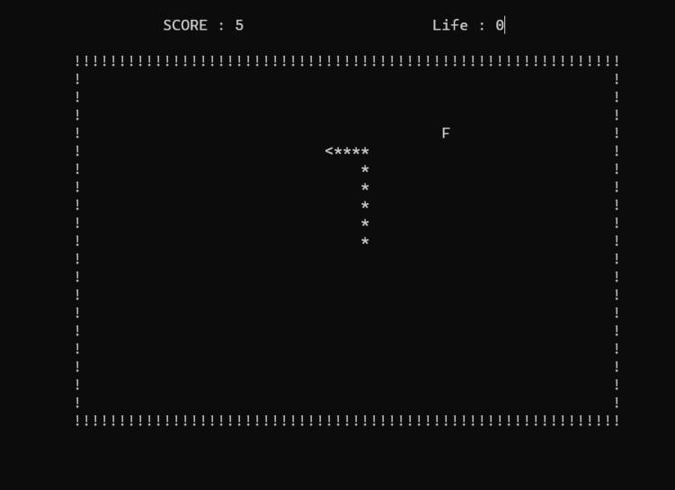
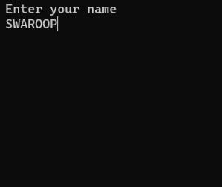

Slide 27

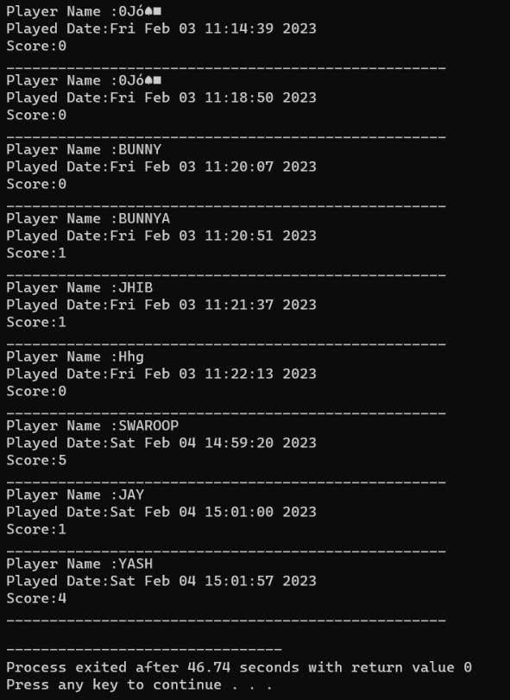

Slide 28
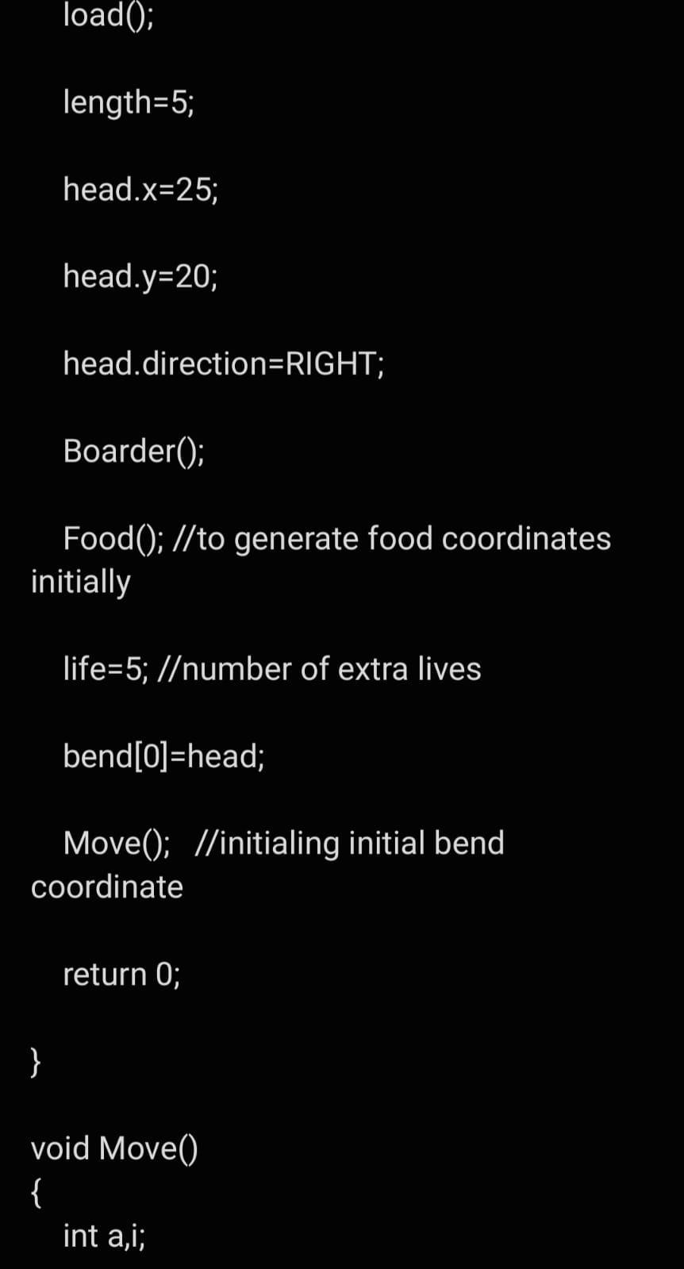
BEFORE: THERE ARE THREE LIVES FOR SNAKE.
AFTER: THERE ARE FIVE LIVES FOR SNAKE.
THE IMPROVEMENT OF LIVES FOR SNAKE IN THE GIVEN CODE IS SHOWN HERE:

Slide 29
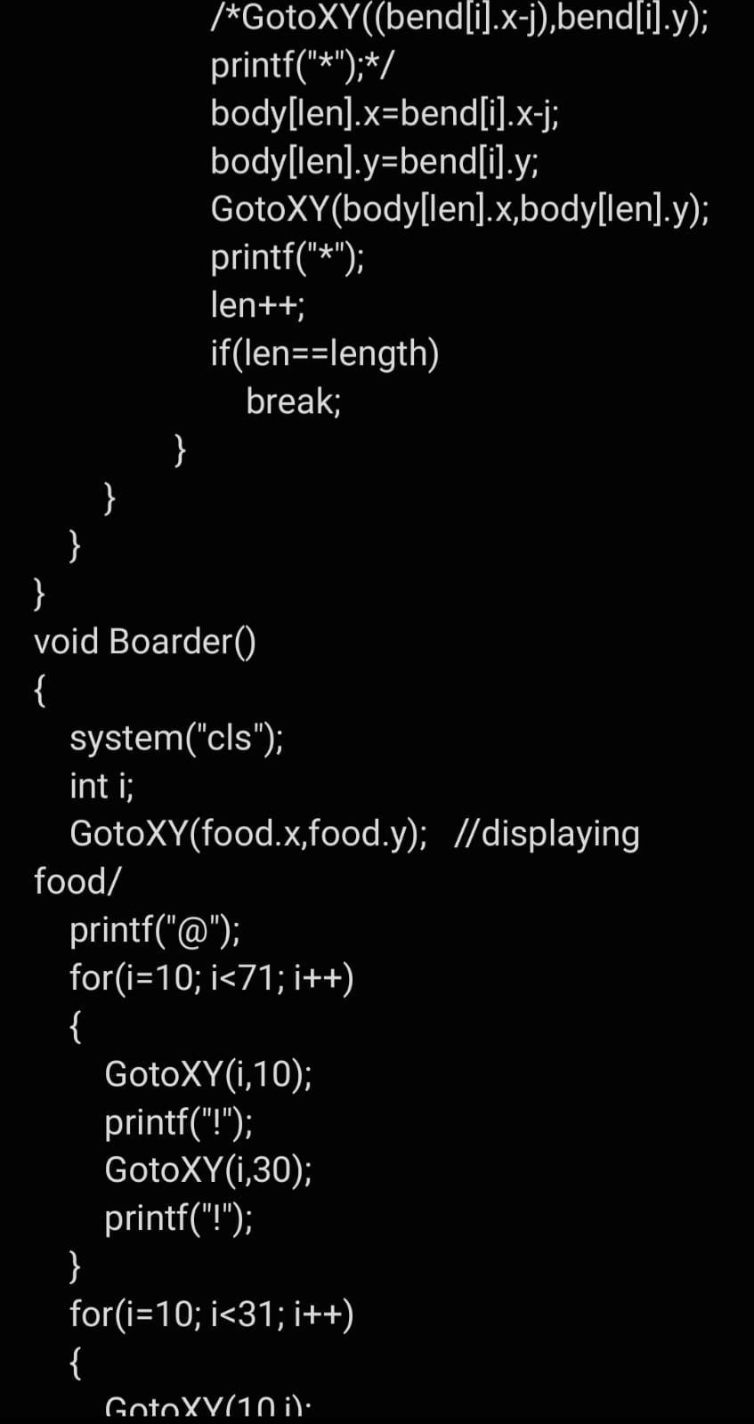
BEFORE: THE FOOD FOR THE SNAKE IS VISIBLED AS ‘F’.
AFTER: THE FOOD FOR THE SNAKE IS VISIBLED AS ‘@’.
THE IMPROVEMENT OF FOOD FOR THE SNAKE IN THE GIVEN CODE IS SHOWN HERE:

Slide 30
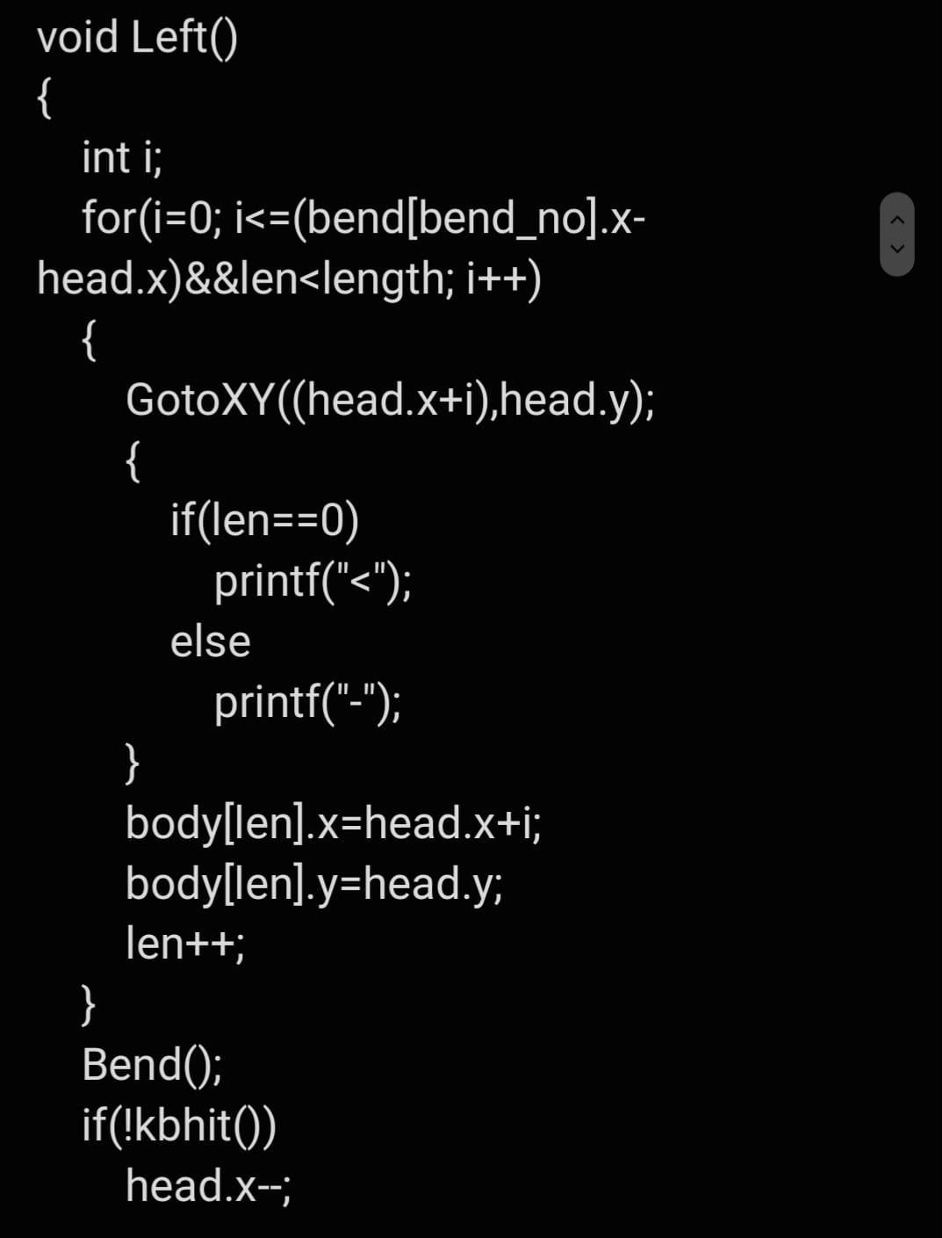
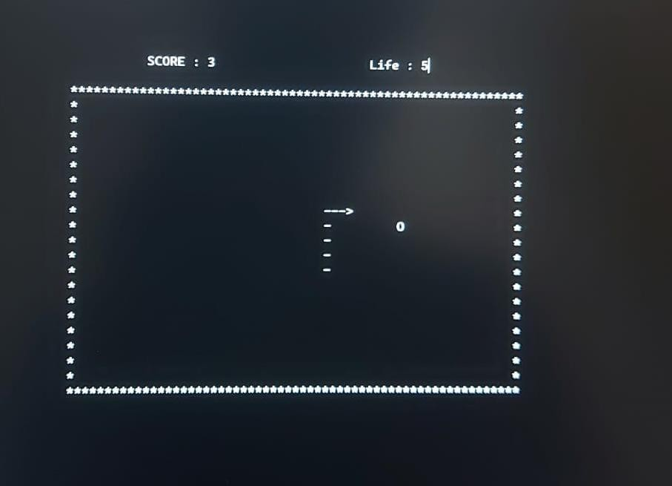
BEFORE: THE TAIL OF THE SNAKE IS IN THE SHAPE OF ‘*’.
AFTER: THE TAIL OF THE SNAKE IS IN THE SHAPE OF ‘-’.
THE IMPROVEMENT OF THE TAIL OF THE SNAKE IN THE GIVEN CODE IS SHOWN HERE:

Slide 31
FUTURE SCOPE SUGGESTIONS:
Add different levels to the game to increase the difficulty and challanges.
Allow the user to adjust the speed of the snake for more control.
Add powerups to the game, such as extra points or invisibility.
Allow the user to customize the appearance of the snake.

Slide 32
Add additional game modes such as time attack or team mode.
Allow for multiple snakes on the same board. 7.Extend the game to a two player mode.
8.Enable the game to be played with game controller. 9.Increase the lives of the snake.
10.Increase the score of the food by adding limited time.

Slide 33



